Slide 1

JavaScript Between Lines

Slide 2
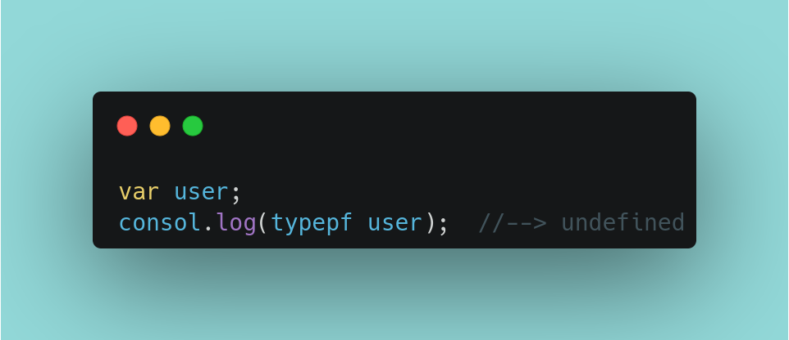
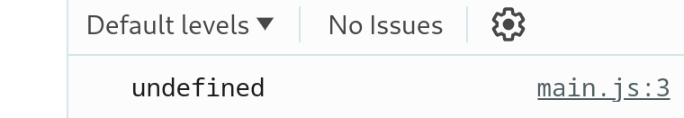
Variable Tricks
Type of `NULL` is → Object
When you define variable and that variable not assigned to value the type of that variable is undefined

Slide 3
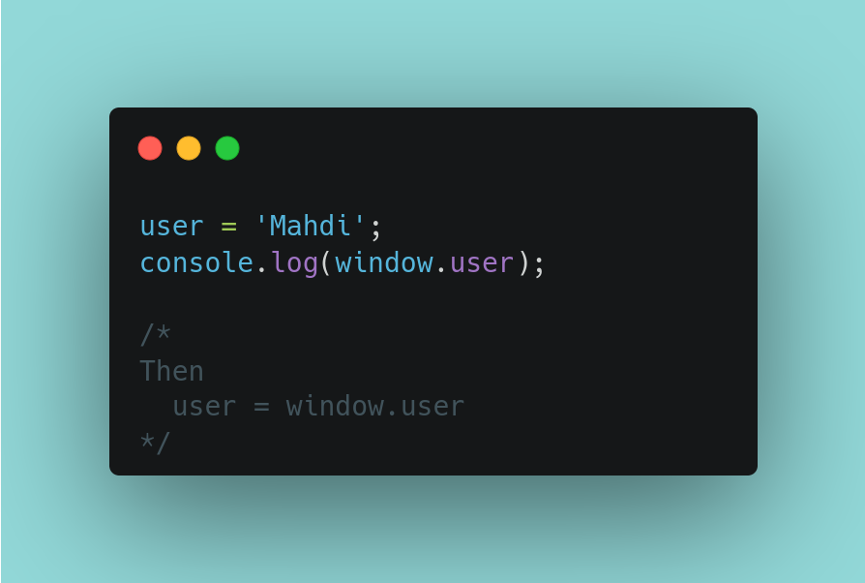
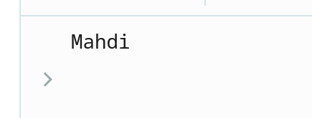
Variable Tricks (Cont.)
If you declare variable without any keyword such var , let or const . This variable will consider GLOBAL variable for Window object , so if we can call this variable with` <the objectname>.variable name`

Slide 4
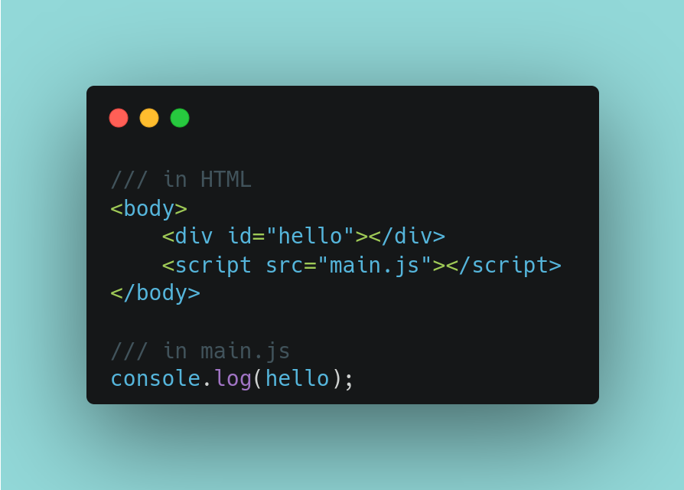

Variable Tricks (Cont.)
In html if you create element with “ID=’hello’” in your window you will have ‘variable name = hello’

